Slide 1




GRADE 10 · ALGEBRA II · TOPIC 2
Lesson 2-4
Overview of
Complex Numbers
Journey of 6 stations, 60 minutes
Quadratic Functions and Equations
Mr Malek Thiab
FAITH, RIGHTEOUSNESS AND WISDOM
Notes:
Speaker notes: Welcome to Lesson 2-4: Overview of Complex Numbers.
Timing: 60 minutes (Diagnose 6, Targeted Instruction 18, Practice 12, Production 12, Mastery Gate 6, Smart Production 6). For a 40-minute class scale every station by two thirds.
The journey map on the next slide shows the six stations; in slideshow mode the Morph transition zooms the station circles into the breadcrumb at the top of every later slide.

Slide 2


Today's journey
Six stations. Each one zooms in as we arrive.
Targeted Instruction
18 min
Production
12 min
Smart Production
6 min
2
4
6
1
3
5
Diagnose
6 min
Practice
12 min
Mastery Gate
6 min
FAITH, RIGHTEOUSNESS AND WISDOM
Notes:
Speaker notes: This is the whole map. Walk it left to right: Diagnose (what we already know), Targeted Instruction (The imaginary unit i; Add, subtract and multiply; Conjugates, modulus and the complex plane; Dividing and complex solutions), Practice (Practice, Apply, Investigate), Production (the NEOM desalination pump circuit), Mastery Gate (three questions to pass), Smart Production (create, then Time to Check).
In slideshow mode the Morph transition animates these circles shrinking into the breadcrumb on later slides; without Morph the slides fade.
Ask the class which station they think will be hardest.

Slide 3
What we are learning
OBJECTIVES
VOCABULARY
Demonstrate the role of the imaginary unit i in the system of complex numbers.
Evaluate expressions involving the imaginary unit i and complex numbers.
Use the properties of complex numbers to perform operations such as addition, subtraction, and multiplication.
Use complex conjugates to simplify quotients of complex numbers.
Solve real-world problems using complex conjugates.
Express the complex solutions of a quadratic equation in the form a + bi.
Argument
complex conjugate
complex number
complex plane
imaginary axis
imaginary part
imaginary unit
Modulus
Norm
purely imaginary number
real axis
real part
HSN.CN.A.1 · HSN.CN.A.2 · HSN.CN.A.3 · HSN.CN.C.8 · HSA.REI.B.4.B
FAITH, RIGHTEOUSNESS AND WISDOM
Mr Malek Thiab · 3
Notes:
Speaker notes: Read the objectives aloud one at a time and have students say which one they feel least sure about.
Vocabulary used today: Argument, complex conjugate, complex number, complex plane, imaginary axis, imaginary part, imaginary unit, Modulus, Norm, purely imaginary number, real axis, real part.
Standards are on the next slide.
The essential question and mathematical practices are not shown because they are not in the project documents; add them from the curriculum map if you want them displayed.

Slide 4
Standards
HSN.CN.A.1 Know there is a complex number i such that i2 = -1, and every complex number has the form a + bi with a and b real.
HSN.CN.A.2 Use the relation i2 = -1 and the commutative, associative, and distributive properties to add, subtract, and multiply complex numbers.
HSN.CN.A.3 Find the conjugate of a complex number; use conjugates to find moduli and quotients of complex numbers.
HSN.CN.C.8 Extend polynomial identities to the complex numbers.
HSA.REI.B.4.B Solve quadratic equations by inspection (e.g., for x2 = 49), taking square roots, completing the square, the quadratic formula and factoring, as appropriate to the initial form of the equation. Recognize when the quadratic formula gives complex solutions and write them as a ± bi for real numbers a and b.
HSN.CN.A.1 · HSN.CN.A.2 · HSN.CN.A.3 · HSN.CN.C.8 · HSA.REI.B.4.B
FAITH, RIGHTEOUSNESS AND WISDOM
Mr Malek Thiab · 4
Notes:
Speaker notes: Standards are quoted verbatim from the curriculum map. Students do not need to read them aloud; point to the ones that match today's objectives.

Slide 5
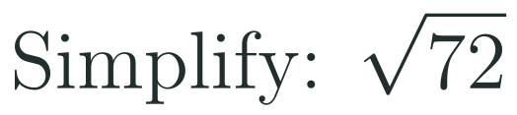
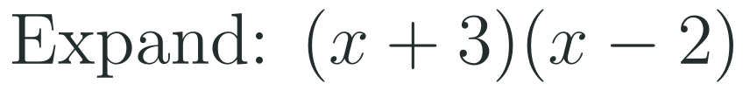
1
2
3
4
5
6
STATION 1 · DIAGNOSE · 6 MIN
Start here: three quick checks
1
2
3
Done when
All three answers are written without a calculator, and you can say what a negative discriminant tells you about the real solutions.
HSN.CN.A.1 · HSN.CN.A.2 · HSN.CN.A.3 · HSN.CN.C.8 · HSA.REI.B.4.B
FAITH, RIGHTEOUSNESS AND WISDOM
Mr Malek Thiab · 5
Notes:
Speaker notes (Diagnose, 6 min, no calculator):
Answers. Q1: sqrt(72) = sqrt(36 x 2) = 6 sqrt(2). Q2: (x+3)(x-2) = x^2 - 2x + 3x - 6 = x^2 + x - 6. Q3: b^2 - 4ac = 2^2 - 4(1)(5) = 4 - 20 = -16; it is negative, so there are no real solutions (the parabola never meets the x-axis) - today we find the solutions that do exist. Verbal misconceptions: Q1 students stop at 2 sqrt(18) (not the largest square factor) or write 8.49; Q2 students write x^2 - 6 (middle terms forgotten) or x^2 - x - 6 (sign slip); Q3 students compute 4 + 20 = 24 (sign error on -4ac) or say 'no solutions at all' - say 'no REAL solutions'. Adaptive routing: if >30% miss Q1, spend 2 minutes on simplifying square roots with the largest perfect square, then go to slide 7 / block 1; if >30% miss Q2, rehearse expanding two brackets before slide 8 / block 2 (multiplying complex numbers uses the same distributive steps); if >30% miss Q3, recap b^2 - 4ac before slide 10 / block 4. If all three are secure, move quickly through slide 7 and start the Investigate route early.

Slide 6

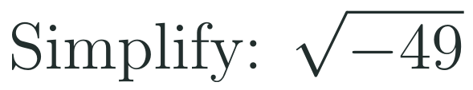

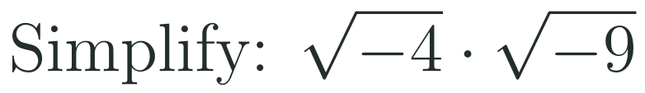
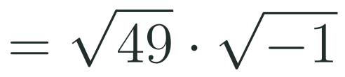


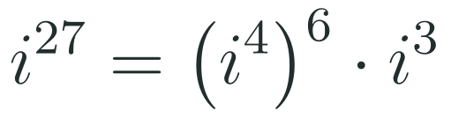


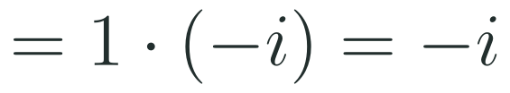

1
2
3
4
5
6
STATION 2 · TARGETED INSTRUCTION · 18 MIN
The imaginary unit i
EXAMPLE A
EXAMPLE B
EXAMPLE C
HSN.CN.A.1 · HSN.CN.A.2 · HSN.CN.A.3 · HSN.CN.C.8 · HSA.REI.B.4.B
FAITH, RIGHTEOUSNESS AND WISDOM
Mr Malek Thiab · 6
Notes:
Speaker notes (Targeted Instruction, block 1 of 4):
Worked solutions. The imaginary unit i is defined by i^2 = -1, so i is a square root of -1; for any positive real number b, sqrt(-b) = i sqrt(b). A number such as 7i (real part 0) is a purely imaginary number. Example 1: sqrt(-49) = sqrt(49) x sqrt(-1) = 7i. Check: (7i)^2 = 49 i^2 = -49. Example 2: the powers of i repeat every 4: i, -1, -i, 1. Divide the exponent by 4: 27 = 4 x 6 + 3, remainder 3. So i^27 = (i^4)^6 x i^3 = 1^6 x (-i) = -i. Example 3: write each root with i FIRST: sqrt(-4) = 2i and sqrt(-9) = 3i. Then 2i x 3i = 6 i^2 = 6(-1) = -6. Verbal misconceptions: (1) sqrt(-4) x sqrt(-9) is NOT sqrt(36) = 6 - the product rule for square roots only holds for non-negative numbers, so always take out i first; (2) i^2 is -1, not 1 and not -i; (3) for powers of i use the remainder after dividing by 4, not the quotient (27 gives remainder 3, not 6); (4) remainder 0 means i^4 = 1, not i^0 confusion. Adaptive routing: if >30% answer +6 for Example 3 on whiteboards, repeat with sqrt(-2) x sqrt(-8) = (i sqrt 2)(i sqrt 8) = i^2 sqrt 16 = -4; if >30% miss Q1 of the Mastery Gate, come back to this slide (slide 7 / block 1).

Slide 7
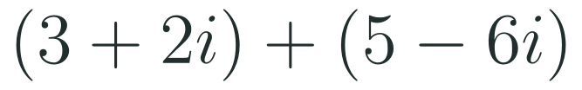
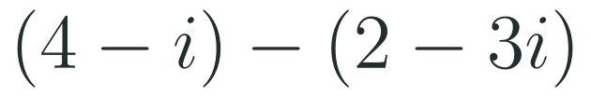
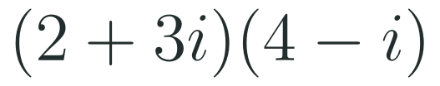
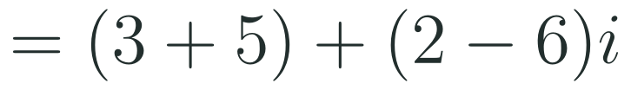




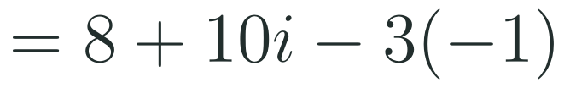

1
2
3
4
5
6
STATION 2 · TARGETED INSTRUCTION · 18 MIN
Add, subtract and multiply
EXAMPLE A
EXAMPLE B
EXAMPLE C
HSN.CN.A.1 · HSN.CN.A.2 · HSN.CN.A.3 · HSN.CN.C.8 · HSA.REI.B.4.B
FAITH, RIGHTEOUSNESS AND WISDOM
Mr Malek Thiab · 7
Notes:
Speaker notes (Targeted Instruction, block 2 of 4):
Worked solutions. Every complex number has the form a + bi with a and b real: a is the real part and b is the imaginary part (b, not bi). Adding and subtracting: combine real parts with real parts and imaginary parts with imaginary parts, exactly like collecting like terms (commutative and associative properties). Example 1: (3 + 2i) + (5 - 6i) = (3 + 5) + (2 - 6)i = 8 - 4i. Example 2: (4 - i) - (2 - 3i): distribute the minus sign to BOTH parts: 4 - i - 2 + 3i = 2 + 2i. Example 3: (2 + 3i)(4 - i): distribute (FOIL): 2 x 4 = 8, 2 x (-i) = -2i, 3i x 4 = 12i, 3i x (-i) = -3i^2. Collect: 8 + 10i - 3i^2; replace i^2 by -1: 8 + 10i + 3 = 11 + 10i. Verbal misconceptions: (1) in Example 2 students write 4 - i - 2 - 3i = 2 - 4i (the minus sign not distributed to the second term); (2) in Example 3 students multiply only the first terms and the last terms (8 and -3i^2, giving 11) and miss the middle terms -2i and 12i - all four products are needed; (3) leaving -3i^2 in the answer - the final answer must be in a + bi form with no i^2; (4) the imaginary part of 11 + 10i is 10, not 10i. Adaptive routing: if >30% get 2 - 4i for Example 2, redo it writing -(2 - 3i) = -2 + 3i on its own line; if >30% miss Q2 of the Mastery Gate come back to this slide (slide 8 / block 2).

Slide 8



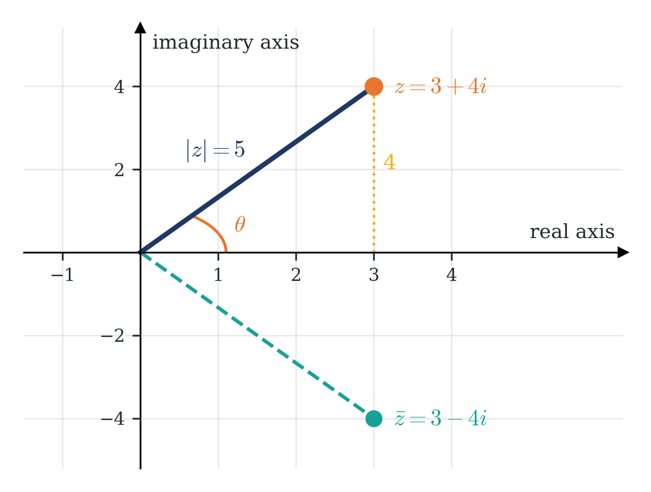
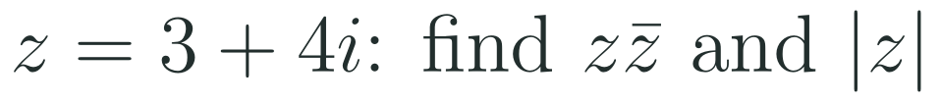

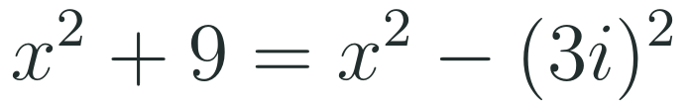

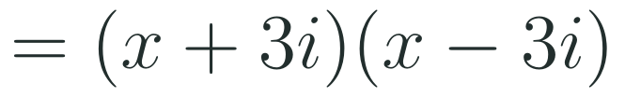
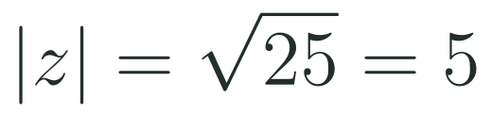
1
2
3
4
5
6
STATION 2 · TARGETED INSTRUCTION · 18 MIN
Conjugates, modulus and the complex plane
EXAMPLE A
EXAMPLE B
HSN.CN.A.1 · HSN.CN.A.2 · HSN.CN.A.3 · HSN.CN.C.8 · HSA.REI.B.4.B
FAITH, RIGHTEOUSNESS AND WISDOM
Mr Malek Thiab · 8
Notes:
Speaker notes (Targeted Instruction, block 3 of 4):
Worked solutions. The complex plane has a horizontal real axis and a vertical imaginary axis: a + bi is the point (a, b). The complex conjugate of a + bi is a - bi: the reflection in the real axis (see the figure: z = 3 + 4i and its conjugate 3 - 4i). The modulus |z| is the distance from 0 to z, found by Pythagoras: sqrt(a^2 + b^2). The product z times its conjugate is a^2 + b^2, called the norm; it is always real and never negative. The angle theta from the positive real axis to z is the argument (here about 53.13 degrees, since tan theta = 4/3) - name it only, it is used in later lessons. Example 1: z = 3 + 4i, z times conjugate = (3 + 4i)(3 - 4i) = 9 - 12i + 12i - 16i^2 = 9 + 16 = 25. The middle terms cancel. |z| = sqrt(3^2 + 4^2) = sqrt(25) = 5, which is the length of the navy segment in the figure. Example 2 (factor over the complex numbers - polynomial identities extended to complex numbers): the difference of squares a^2 - b^2 = (a + b)(a - b) works with b = 3i because (3i)^2 = -9, so x^2 + 9 = x^2 - (3i)^2 = (x + 3i)(x - 3i). Check: x^2 - 3ix + 3ix - 9i^2 = x^2 + 9. Verbal misconceptions: (1) the conjugate changes the sign of the imaginary part only: the conjugate of 3 + 4i is 3 - 4i, not -3 - 4i or -3 + 4i; (2) (3 + 4i)(3 - 4i) is 9 + 16 = 25, NOT 9 - 16 = -7 (students forget i^2 = -1); (3) |3 + 4i| is 5, not 3 + 4 = 7 and not sqrt(9 - 16); (4) x^2 + 9 does not factor over the real numbers, but it does over the complex numbers. Adaptive routing: if >30% give -7 for Example 1, write the four FOIL products on the board and circle -16i^2; if Investigate students finish early, ask them why every z times its conjugate lands on the real axis; Gate Q3 errors with the conjugate route back here (slide 9 / block 3) before slide 10.

Slide 9


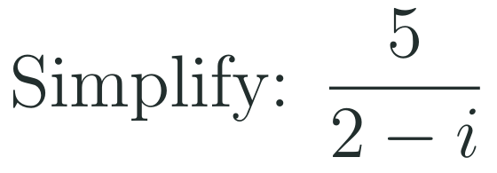
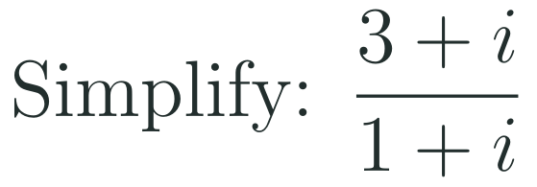


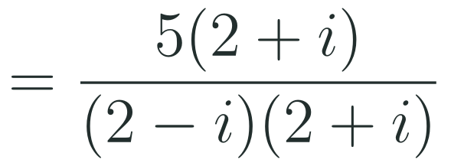
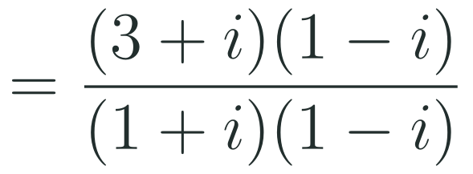
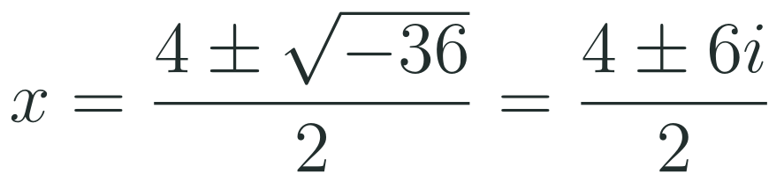
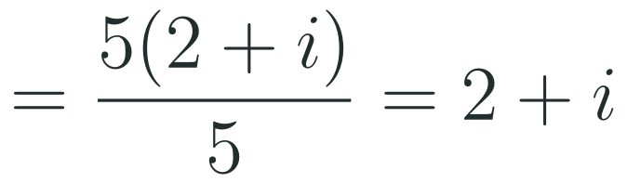
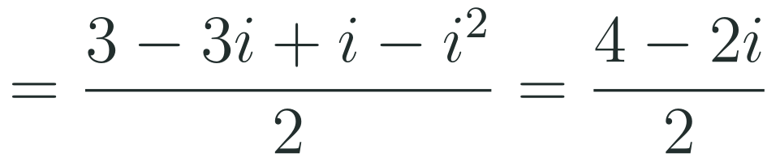


1
2
3
4
5
6
STATION 2 · TARGETED INSTRUCTION · 18 MIN
Dividing and complex solutions
EXAMPLE A
EXAMPLE B
EXAMPLE C
HSN.CN.A.1 · HSN.CN.A.2 · HSN.CN.A.3 · HSN.CN.C.8 · HSA.REI.B.4.B
FAITH, RIGHTEOUSNESS AND WISDOM
Mr Malek Thiab · 9
Notes:
Speaker notes (Targeted Instruction, block 4 of 4):
Worked solutions. To divide, multiply the numerator AND the denominator by the conjugate of the denominator; the denominator becomes c^2 + d^2, a real number, so the result can be written as a + bi. Example 1: 5/(2 - i): multiply by (2 + i)/(2 + i). Denominator (2 - i)(2 + i) = 4 + 1 = 5. Numerator 5(2 + i). So 5(2 + i)/5 = 2 + i. Check: (2 + i)(2 - i) = 5. Example 2: (3 + i)/(1 + i): multiply by (1 - i)/(1 - i). Denominator 1 + 1 = 2. Numerator (3 + i)(1 - i) = 3 - 3i + i - i^2 = 3 - 2i + 1 = 4 - 2i. Divide each part by 2: 2 - i. Check: (2 - i)(1 + i) = 2 + 2i - i - i^2 = 3 + i. Example 3: x^2 - 4x + 13 = 0 with a = 1, b = -4, c = 13. Discriminant 16 - 52 = -36 < 0, so no real solutions but two complex solutions. sqrt(-36) = 6i. x = (4 +/- 6i)/2 = 2 +/- 3i. Check: (2 + 3i)^2 - 4(2 + 3i) + 13 = (4 + 12i - 9) - 8 - 12i + 13 = 0. The two solutions are conjugates of each other. Verbal misconceptions: (1) multiplying only the denominator by the conjugate changes the value - multiply top and bottom; (2) dividing only the real part by 2 in Example 2 (writing 2 - 2i); (3) in Example 3, -b is +4 (sign error gives -2 +/- 3i); (4) writing x = 2 +/- 6i (forgetting to divide the 6i by 2) - a partial-step trap used on SAT and Tahsili. Adaptive routing: if >30% miss Q3 of the Mastery Gate come back to this slide (slide 10 / block 4); if >30% stall on Example 3, recap the discriminant from Diagnose Q3 (slide 6) and then sqrt(-36) = 6i from slide 7.

Slide 10
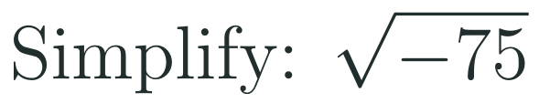
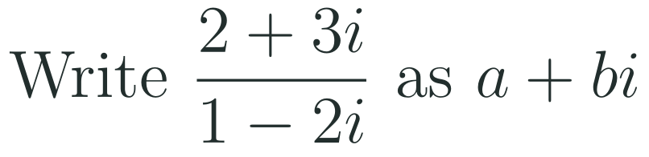
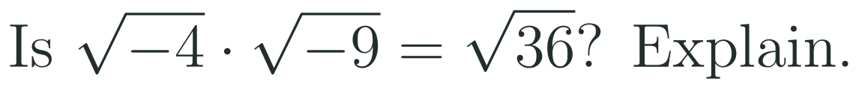
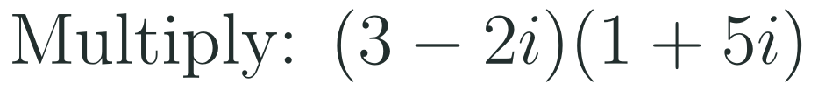

1
2
3
4
5
6
STATION 3 · PRACTICE · 12 MIN
Give it a go: Practice, Apply, Investigate
PRACTICE
APPLY
INVESTIGATE
Secure the method
Use it in context
Find out why
Done when: both answers are written in the form a + bi with no i squared left and every step shown.
Done when: the quotient is checked by multiplying back and both solutions are written as a + bi and checked by substitution.
Done when: your argument uses i squared equals -1 in general terms, not just one numerical example.
HSN.CN.A.1 · HSN.CN.A.2 · HSN.CN.A.3 · HSN.CN.C.8 · HSA.REI.B.4.B
FAITH, RIGHTEOUSNESS AND WISDOM
Mr Malek Thiab · 10
Notes:
Speaker notes (Practice, 12 min; tierless differentiation: students choose the starting column and may move across):
Answers. Practice 1: sqrt(-75) = sqrt(25 x 3) x i = 5 sqrt(3) i (in a + bi form: 0 + 5 sqrt(3) i). Practice 2: (3 - 2i)(1 + 5i) = 3 + 15i - 2i - 10i^2 = 3 + 13i + 10 = 13 + 13i. Apply 1: multiply by (1 + 2i)/(1 + 2i): denominator 1 + 4 = 5; numerator (2 + 3i)(1 + 2i) = 2 + 4i + 3i + 6i^2 = -4 + 7i; answer -4/5 + (7/5)i. Check: (-4/5 + 7/5 i)(1 - 2i) = -4/5 + 8/5 i + 7/5 i - 14/5 i^2 = -4/5 + 14/5 + 15/5 i = 2 + 3i. Apply 2: discriminant 36 - 40 = -4, sqrt(-4) = 2i, x = (-6 +/- 2i)/2 = -3 +/- i. Check: (-3 + i)^2 + 6(-3 + i) + 10 = (9 - 6i - 1) - 18 + 6i + 10 = 0. Investigate 1: (a + bi)(a - bi) = a^2 - abi + abi - b^2 i^2 = a^2 + b^2; the imaginary terms cancel and i^2 = -1 turns -b^2 i^2 into +b^2, so the result is real (and never negative) for all real a and b. Investigate 2: No. sqrt(-4) x sqrt(-9) = 2i x 3i = 6i^2 = -6, but sqrt(36) = 6. The rule sqrt(a) x sqrt(b) = sqrt(ab) needs a and b non-negative. Verbal misconceptions: students choose the route that feels comfortable - remind them they may switch at any time; 3 - 13i in Practice 2 (sign of -10i^2 mishandled); in Apply 1 forgetting to multiply the numerator by the conjugate. Adaptive routing: if >30% of Practice students miss item 2, route them to slide 8 / block 2 Example 3 with a partner; if >30% of Apply students stall on item 1, return to slide 10 / block 4 Example 2; if Investigate stalls, point to slide 9 / block 3 and the figure.

Slide 11
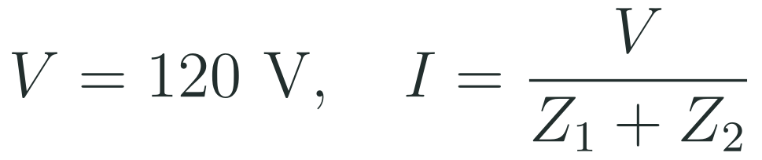
1
2
3
4
5
6
STATION 4 · PRODUCTION · 12 MIN
Production: the NEOM desalination pump circuit
THE MODEL
DONE WHEN
At a NEOM coastal desalination plant (a Vision 2030 project on the Red Sea), engineers check the alternating current (AC) feeding a seawater pump motor. In AC circuits, resistance and reactance combine into a complex impedance Z measured in ohms, and the current is the voltage divided by the impedance. Two parts of the circuit are connected in series, so their impedances add. All numbers are model values chosen for this lesson, not real plant data.
Z is found by adding real parts and imaginary parts separately.
The current is written as a + bi after multiplying the top and the bottom by the conjugate.
The modulus is found with the square root of a squared plus b squared and is labelled in amperes.
The breaker decision is written in a full sentence and states that the numbers are model values.
Add the two impedances to find the total impedance Z in the form a + bi.
Use the complex conjugate of Z to write the current I in the form a + bi.
Find the size (modulus) of the current and decide whether a 30 A circuit breaker is enough.
Hint for solving: the size of a quotient is the size of the top divided by the size of the bottom, so you can check your modulus as 120 divided by the modulus of Z.
HSN.CN.A.1 · HSN.CN.A.2 · HSN.CN.A.3 · HSN.CN.C.8 · HSA.REI.B.4.B
FAITH, RIGHTEOUSNESS AND WISDOM
Mr Malek Thiab · 11
Notes:
Speaker notes (Production, 12 min):
Model values only. Task 1: Z = Z1 + Z2 = (2 + 1) + (3 + 1)i = 3 + 4i ohms. Task 2: I = 120/(3 + 4i). Multiply top and bottom by the conjugate 3 - 4i: denominator (3 + 4i)(3 - 4i) = 9 + 16 = 25; numerator 120(3 - 4i) = 360 - 480i. I = (360 - 480i)/25 = 14.4 - 19.2i amperes (exactly 72/5 - (96/5)i). Check: (14.4 - 19.2i)(3 + 4i) = 43.2 + 57.6i - 57.6i - 76.8i^2 = 43.2 + 76.8 = 120. Task 3: |I| = sqrt(14.4^2 + 19.2^2) = sqrt(207.36 + 368.64) = sqrt(576) = 24 A. Check with the hint: |I| = 120/|Z| = 120/5 = 24 A. 24 A is less than 30 A, so the 30 A breaker is enough in this model (with 6 A of margin). Note for the teacher: electrical engineers write j instead of i so it is not confused with current, but the mathematics is identical. Verbal misconceptions: students divide 120 by 3 and by 4 separately (120/3 + 120/4 i = 40 + 30i), which is wrong because you cannot split a denominator; students forget the minus sign and write 14.4 + 19.2i; students give the size as 14.4 + 19.2 = 33.6 A (adding parts instead of Pythagoras) and wrongly conclude the breaker is too small. Adaptive routing: if >30% cannot write the current, return to slide 10 / block 4 Example 1; if >30% miss the modulus, return to slide 9 / block 3 and the figure.

Slide 12

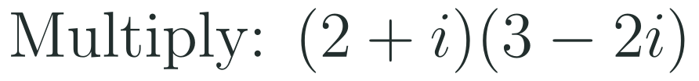
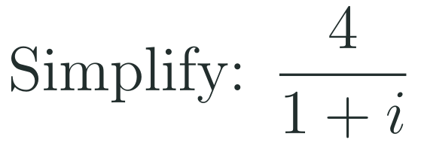
1
2
3
4
5
6
STATION 5 · MASTERY GATE · 6 MIN
Mastery Gate: three questions to pass
1
2
3
Pass mark
3 of 3 correct unlocks Station 6. Fewer than that: return to the slide for the question you missed, redo it, then re-take the gate.
HSN.CN.A.1 · HSN.CN.A.2 · HSN.CN.A.3 · HSN.CN.C.8 · HSA.REI.B.4.B
FAITH, RIGHTEOUSNESS AND WISDOM
Mr Malek Thiab · 12
Notes:
Speaker notes (Mastery Gate, 6 min, no calculator):
Answers. Q1: 50 = 4 x 12 + 2, remainder 2, so i^50 = i^2 = -1. Q2: (2 + i)(3 - 2i) = 6 - 4i + 3i - 2i^2 = 6 - i + 2 = 8 - i. Q3: multiply top and bottom by 1 - i: denominator (1 + i)(1 - i) = 1 + 1 = 2; numerator 4(1 - i) = 4 - 4i; result (4 - 4i)/2 = 2 - 2i. Check: (2 - 2i)(1 + i) = 2 + 2i - 2i - 2i^2 = 4. Traps to expect: Q1 answers 1 (using the quotient 12 instead of the remainder) or i^2 = 1; Q2 answers 4 - i (i^2 replaced by +1) or 6 - 2i^2 = 8 (only first and last terms); Q3 answers 4 - 4i (denominator dropped), 2 + 2i (conjugate sign slip) or 4/(1 + i) left unsimplified. Adaptive routing: Q1 missed -> slide 7 / block 1; Q2 missed -> slide 8 / block 2; Q3 missed -> slide 10 / block 4 (and slide 9 / block 3 for the conjugate itself). Score live, route privately through the LMS, and never announce the clinic list to the class. If >30% miss any one question, reteach that block with a new example at the start of the next lesson.

Slide 13

1
2
3
4
5
6
STATION 6 · SMART PRODUCTION · 6 MIN
Smart Production: make one, then check it
CREATE
TIME TO CHECK
Write one quadratic equation with integer coefficients that has no real solutions.
Solve it on the back and write both solutions in the form a + bi.
Swap with a partner, solve theirs and check one solution by substitution.
Exit ticket: write your answer on a sticky note and place it on the door.
Done when: your solution is complete and correct, the two solutions are conjugates, and your partner agrees with every step.
Next lesson: 2-5 Completing the Square.
HSN.CN.A.1 · HSN.CN.A.2 · HSN.CN.A.3 · HSN.CN.C.8 · HSA.REI.B.4.B
FAITH, RIGHTEOUSNESS AND WISDOM
Mr Malek Thiab · 13
Notes:
Speaker notes (Smart Production, 6 min):
Exit ticket solution. x^2 + 4x + 13 = 0, a = 1, b = 4, c = 13. Discriminant 16 - 52 = -36, sqrt(-36) = 6i. x = (-4 +/- 6i)/2 = -2 +/- 3i. Check: (-2 + 3i)^2 + 4(-2 + 3i) + 13 = (4 - 12i - 9) - 8 + 12i + 13 = 0. Non-example for the creation task: x^2 - 4x + 3 = 0 is NOT valid because its discriminant 16 - 12 = 4 is positive (solutions 1 and 3 are real); students should check that b^2 - 4ac < 0 before swapping. A quick way to build one: start from a + bi and its conjugate, e.g. 1 +/- 2i gives x^2 - 2x + 5 = 0. Verbal misconceptions: students write 2 +/- 3i (sign of -b), -2 +/- 6i (6i not divided by 2), or 'no solution' (they stop at the negative discriminant). Adaptive routing: if >30% miss the exit ticket, start the next lesson with a 10-minute clinic using slide 10 / block 4 Example 3; completing the square in Lesson 2-5 will reach the same answers by a second method. If time is short, cut Smart Production and carry it over, never the Mastery Gate.

Slide 14
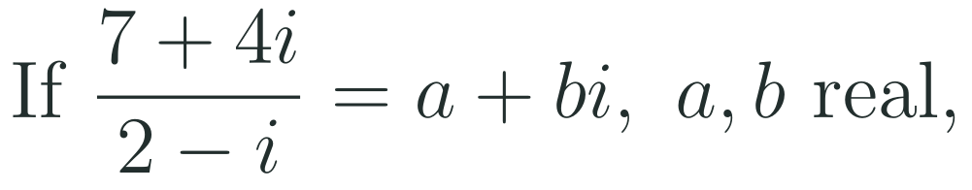

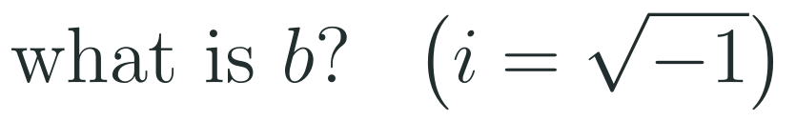
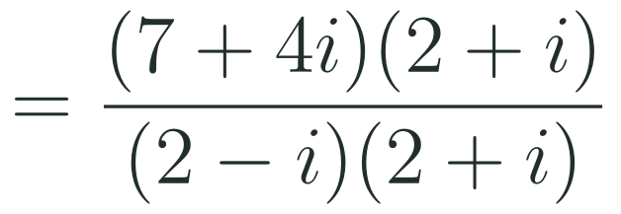

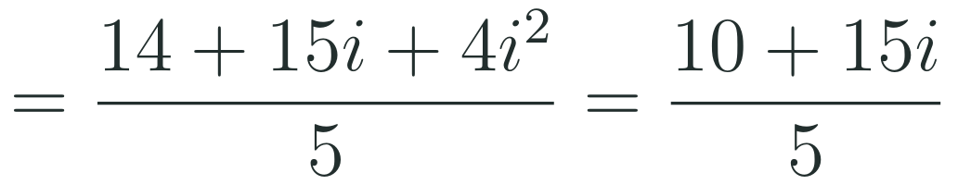
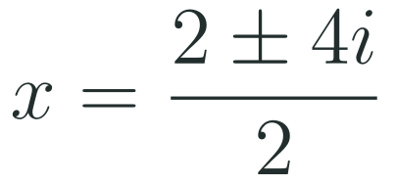



Exam connections
SAT
GAT
SAAT
STEPS
STEPS
STEPS
1
1
1
2
2
2
3
3
3
HSN.CN.A.1 · HSN.CN.A.2 · HSN.CN.A.3 · HSN.CN.C.8 · HSA.REI.B.4.B
FAITH, RIGHTEOUSNESS AND WISDOM
Mr Malek Thiab · 14
Notes:
Speaker notes: each exam item is worked in numbered steps.
SAT (Advanced Math, global style, grid-in or four options): multiply the numerator and the denominator by the conjugate 2 + i. Denominator (2 - i)(2 + i) = 4 + 1 = 5. Numerator (7 + 4i)(2 + i) = 14 + 7i + 8i + 4i^2 = 14 + 15i - 4 = 10 + 15i. So the quotient is (10 + 15i)/5 = 2 + 3i: a = 2, b = 3. Check: (2 + 3i)(2 - i) = 4 - 2i + 6i - 3i^2 = 7 + 4i. Trap: the distractor 2 (the value of a, not b), 15 (forgetting to divide by 5), or 7/2 and -4 (dividing part by part). GAT/Qudurat quantitative comparison (A is greater / B is greater / they are equal / not enough information): 2026 = 4 x 506 + 2, so i^2026 = i^2 = -1; 2028 = 4 x 507 + 0, so i^2028 = i^4 = 1. B (1) is greater than A (-1). Trap: thinking a larger exponent always gives a larger value, choosing 'equal' because both are 'powers of i', or using the quotient instead of the remainder. SAAT/Tahsili (four options, no calculator): a = 1, b = -2, c = 5; discriminant 4 - 20 = -16; sqrt(-16) = 4i; x = (2 +/- 4i)/2 = 1 +/- 2i. Check: (1 + 2i)^2 - 2(1 + 2i) + 5 = (1 + 4i - 4) - 2 - 4i + 5 = 0. Trap: -1 +/- 2i (sign of -b), 1 +/- 4i (partial step: only the real part divided by 2), or 'no solution' (the real-number answer). Adaptive routing: if >30% miss the SAT item, go to slide 10 / block 4 Examples 1-2; if >30% miss the GAT item, go to slide 7 / block 1 Example 2; if >30% miss the SAAT item, go to slide 10 / block 4 Example 3.

Slide 15
Journey complete
Targeted Instruction
Production
Smart Production
✓
✓
✓
✓
✓
✓
Diagnose
Practice
Mastery Gate
i squared is -1: every complex number is a + bi, we add and multiply like binomials, divide with the conjugate, and every quadratic now has solutions.
FAITH, RIGHTEOUSNESS AND WISDOM
Notes:
Speaker notes: Every station is checked off. Recap in one sentence: i squared is -1: every complex number is a + bi, we add and multiply like binomials, divide with the conjugate, and every quadratic now has solutions. Collect the Time to Check responses. Next lesson: 2-5 Completing the Square.

